Slide 1
Competitive Programming
24 Feb. 2023
Andrei Novikov

Slide 2
Hash Table
The Hash Table is advanced technology that allows to perform all operation with average complexity O(1).
The most important part of hash tables is to find a hash function that will allow us to have the average complexity O(1).
In worse case, when hash points to the same element, the complexity will be like list Θ(N).

Slide 3
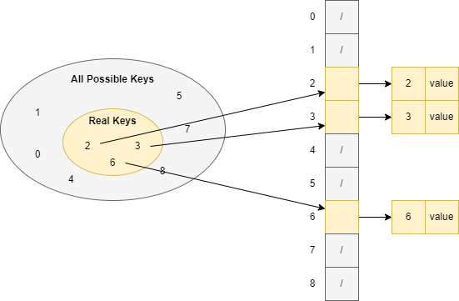
Array as Hash Table
When the range of possible keys is not big enough, then pure array can be used:

Slide 4
Quiz 1
Suppose we have S elements and array with length M. How to find the element with the biggest key value and what is complexity in the worth case?

Slide 5
Quiz 2
Propose an implementation of the hash table when keys might have the same value. Insertion, Remove, Search should be O(1) when a pointer to the element is used.

Slide 6
Array as Hash Table – Disadvantage
When the set of possible keys is too big, then it might be not possible to represent the hash table as an array with direct address. Or it might not efficient, for example:
The number of possible keys is too big.
The number of keys in use is really small.
Need to allocate huge array to keep few keys inside
In this case, hash table are going to be more efficient

Slide 7
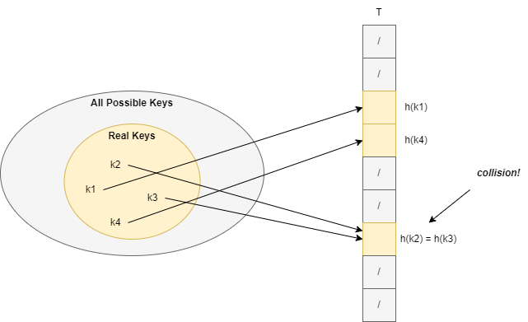
Hash Table
Since the size of T is always smaller than the number of all possible keys, then collisions are always expected.

Slide 8
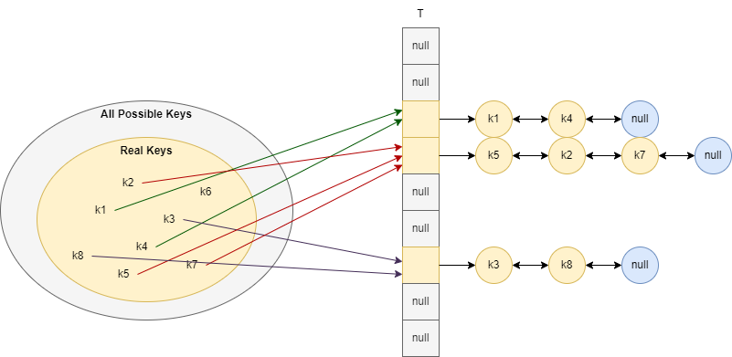
Collision Resolution by Chaining
The average complexity depends on the implementation of hash function.
In case of uniform distribution: T[i] = N/M, where M size of the table, and N the number of possible keys.

Slide 9
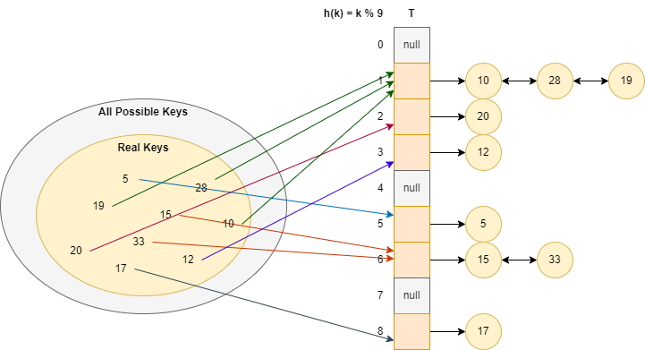
Collision Resolution by Chaining - Example
Table size: 9;
Hash function: h(k) = k mod 9;
Elements to insert: 5, 28, 19, 15, 20, 33, 12, 17, 10;

Slide 10
Hash Functions
Three are three common type of hash functions:
Hash by division;
h(k) = k mod m, the best candidate for m is a prime number, the worse candidate is m is a power of 2 (32, 64, etc.).
Hash by multiplication;
h(k) = floor(m (k A mod 1)), where A is a constant in (0; 1). Advantage – m value is not critical anymore.
Hash by randomization (universal hashing);
The idea is concluded in random selection of the hash function during the application startup or during declaration of the hash table.

Slide 11
Open Addressing and Collision Resolution
In case of open addressing, all elements are stored in array directly.
But instead search in [0, m), we can search in <h(k, 0), h(k, 1), …, h(k, m - 1)>
h(k, i) = h(h₁(k) + ih₂(k)) mod m

Slide 12
Collision Resolution in Open Addressing
In case of open addressing, all elements are stored in array directly.
But instead search in [0, m), we can search in <h(k, 0), h(k, 1), …, h(k, m - 1)>
Double hash to resolve collisions in open addressing hash table:
h(k, i) = h(h₁(k) + ih₂(k)) mod m

Slide 13
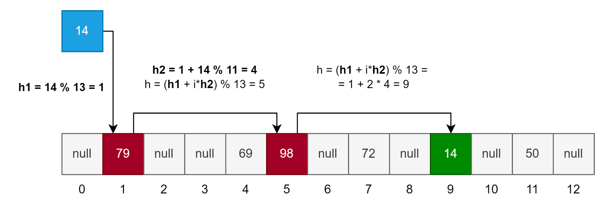
Open Addressing Example
In case of open addressing, all elements are stored in array directly.
But instead search in [0, m), we can search in <h(k, 0), h(k, 1), …, h(k, m - 1)>
Double hash to resolve collisions in open addressing hash table:
h(k, i) = h(h₁(k) + ih₂(k)) mod m
h1(k) = k mod 13
h2(k, i) = 1 + k mod 11

Slide 14
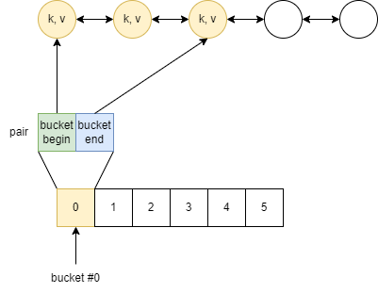


C++ (Visual Studio 2022) Implementation
Simplified scheme of the implementation in C++ (Visual Studio 2022):
Structure:
List of elements;
Vector of pairs (buckets);
Hash function;
Total elements;
Maximum loading factor [0, 1];
Elements: list
Bucket description: pair<>
Buckets: vector
Chaining Approach

Slide 15
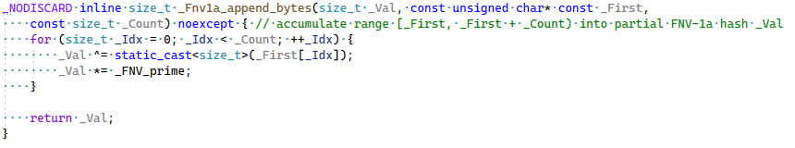
C++ Hash Function Example
Example of the hash function implementation in C++ for integer types (Visual Studio 2022 implementation):
C++ standard defined complexity requirements and interface but does not define implementations.

Slide 16
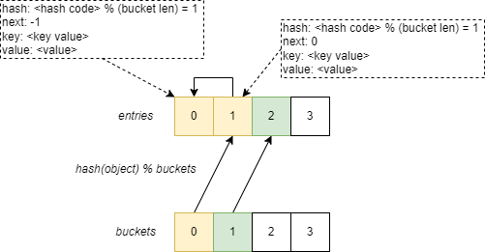
C# Hash Table Implementation
The simplified scheme is looks the same:
Buckets: int[]
Entries: Entry[]
Hash Code;
Next: next entry in Entries array;
Key, Value;
FreeList: Index of the next free element
Count: The total number of elements in the Dictionary<>
Version – variable is updated if content of the dictionary has been changed.
Open Addressing Approach
Link to Source Code on GitHub

Slide 17
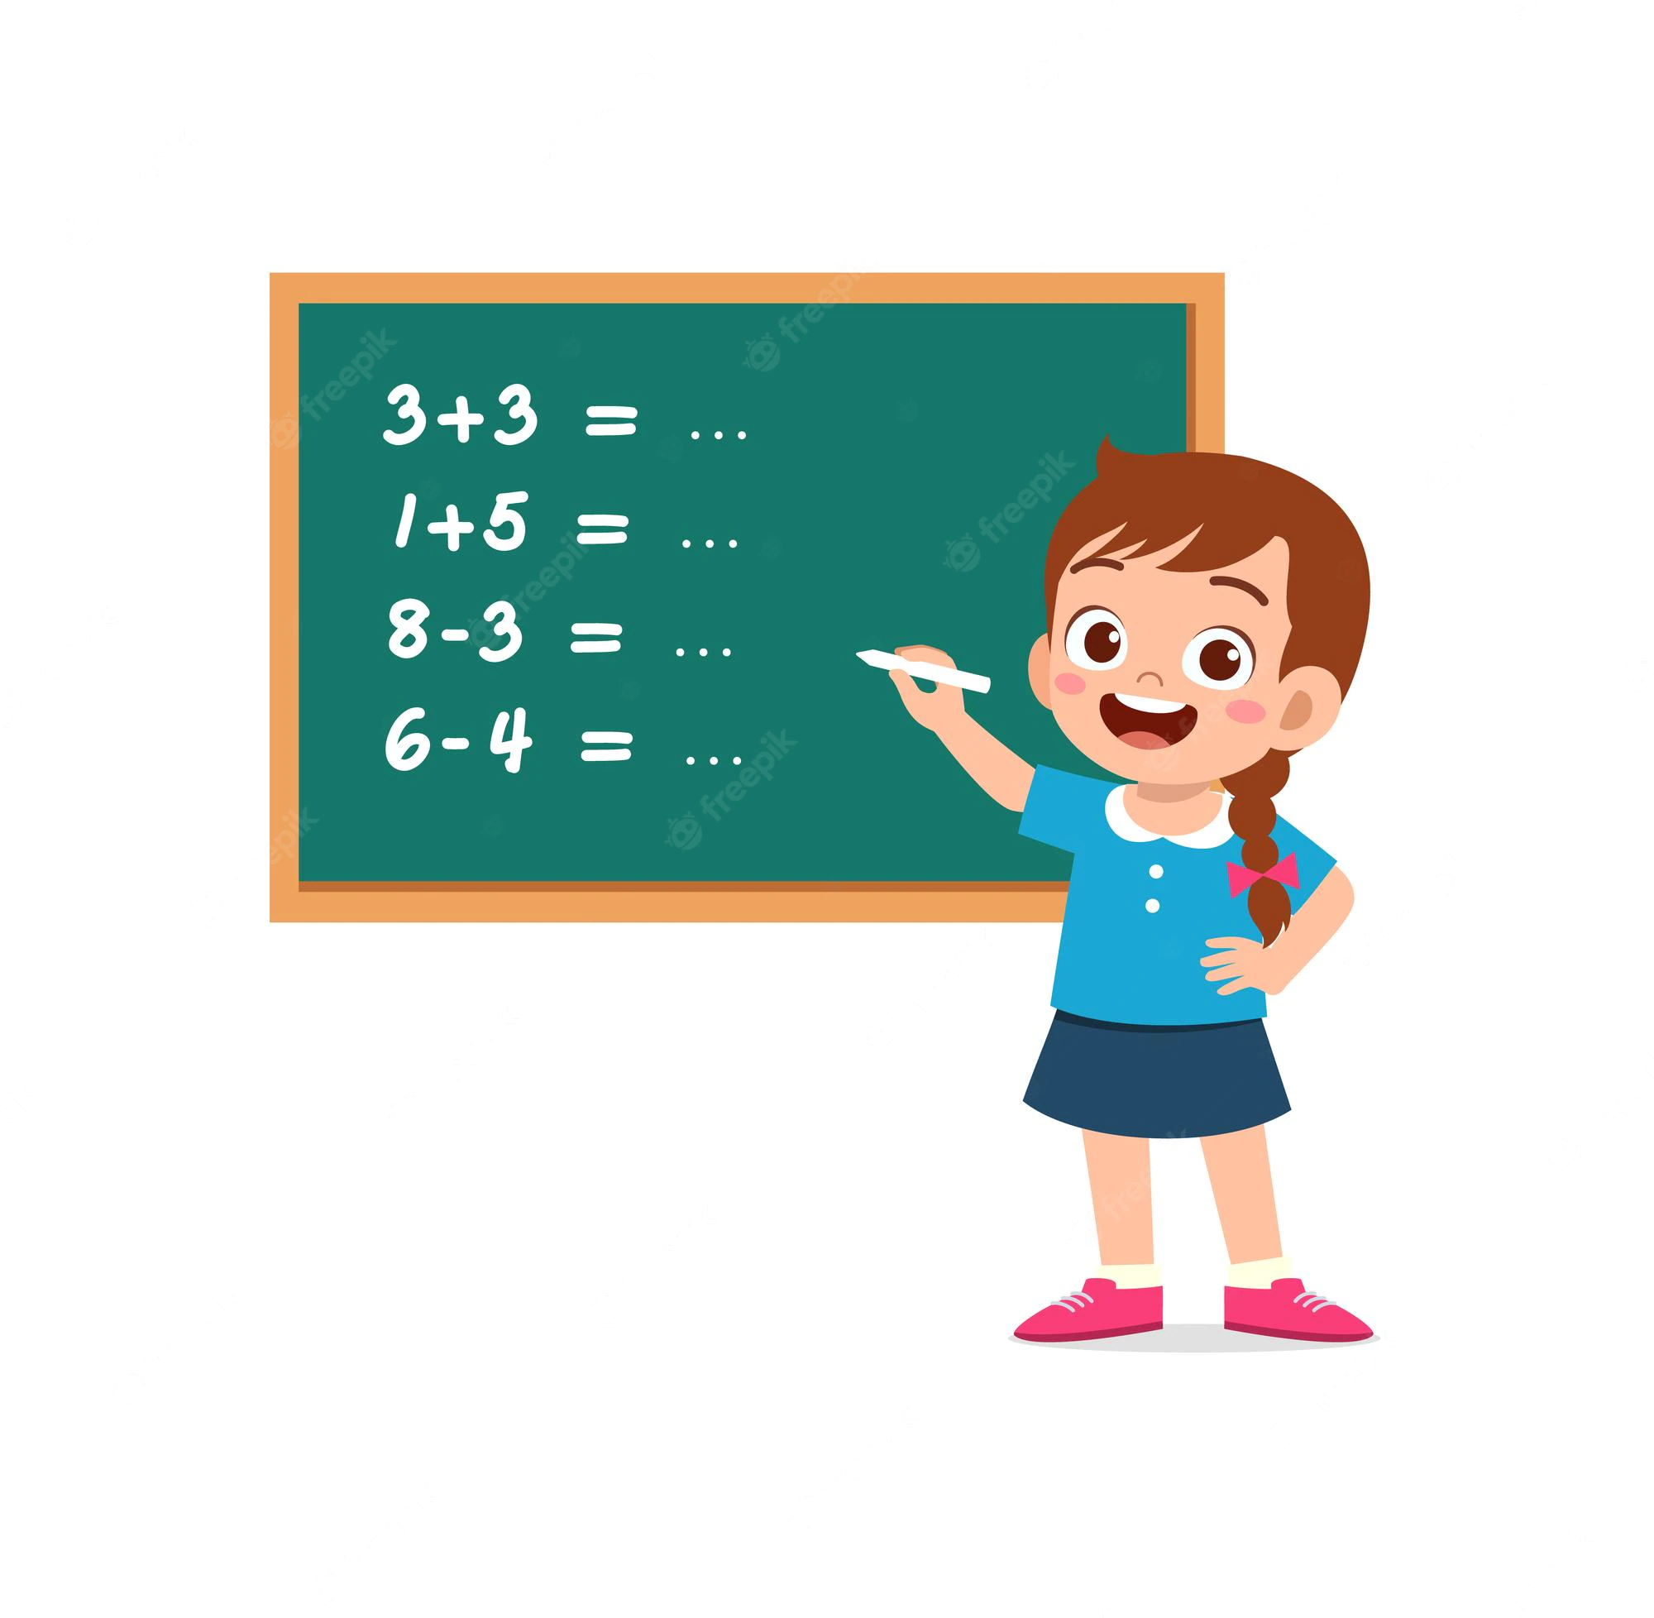
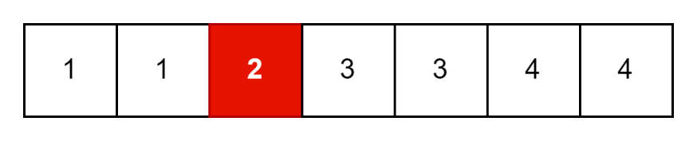
Practice – Challenge #1
Consider the following task:
Sorted array is an input:
Every element appears twice, except one;
Find the element that appears once:
Performance complexity: O(log(N))
Memory complexity: O(1)

Slide 18
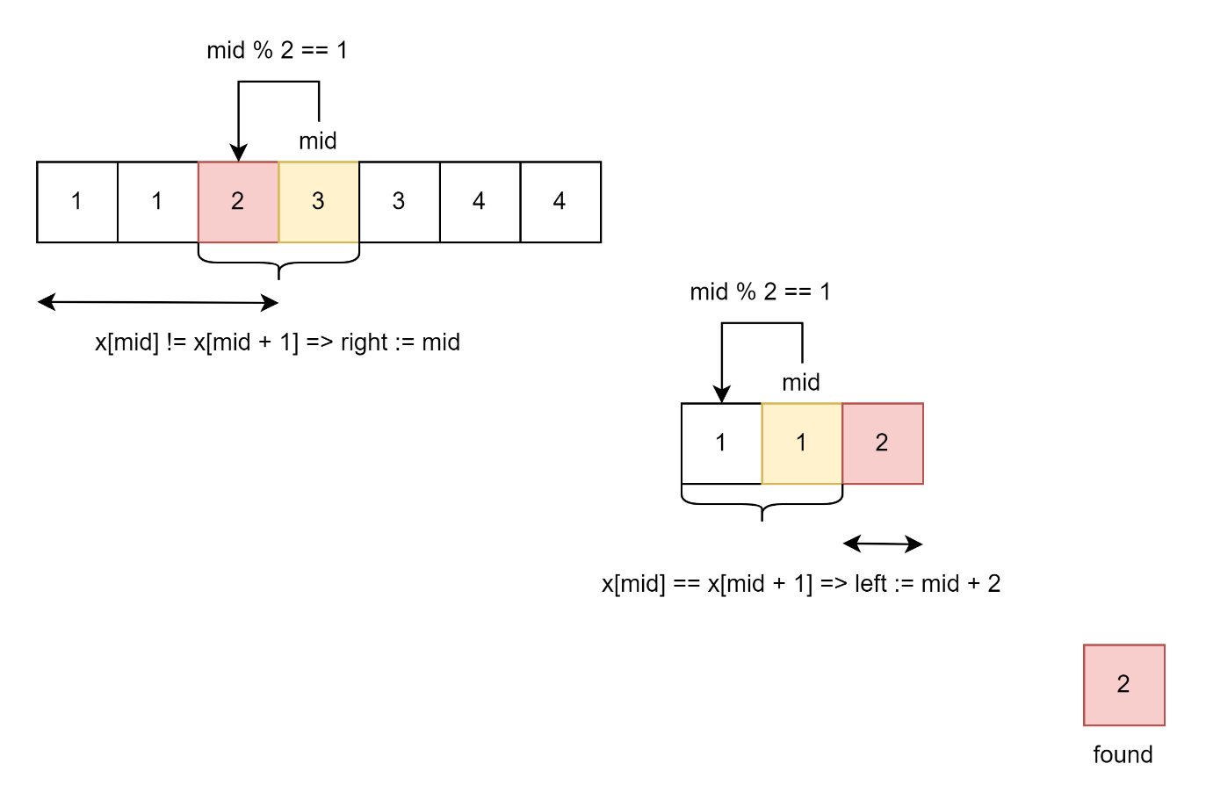
Practice – Challenge #1
Case 1: Middle has odd index.
If x[mid] != x[mid + 1] =>
element is at the left part
If x[mid] == x[mid + 1] =>
element is at the right part

Slide 19
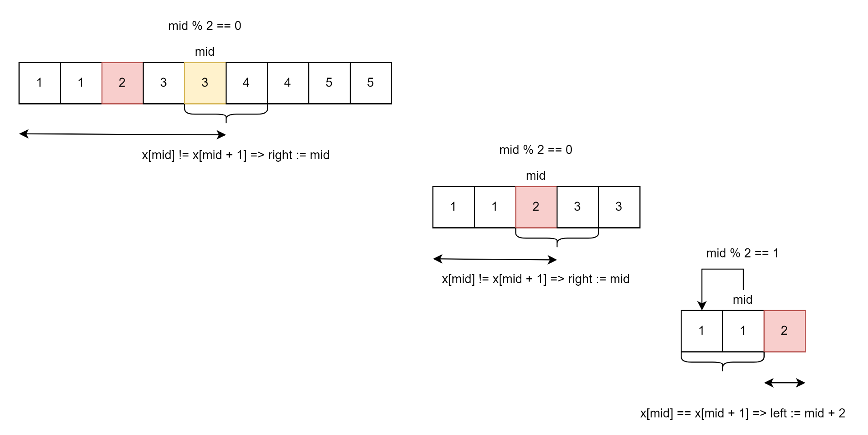
Practice – Challenge #1
Case 2: Middle has even index.

Slide 20
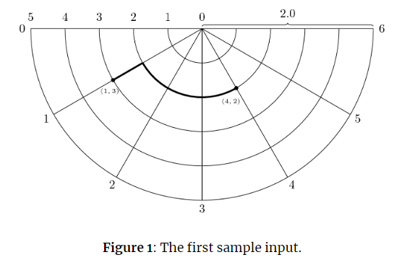
Homework?
Open question. Does not make sense to ask to have homework? Does anyone have desire to have home tasks?
If so, then there is one task – Link on Kattis

Slide 21




Where to Practice
LeetCode [link]
HackerRank [link]
Kattis [link]
TopCoder [link]
Other Resources

